Slide 1
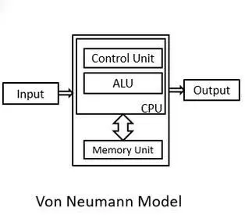
Von Neumann Architecture

Slide 2
In a Von Neumann architecture, instructions and data are stored in a single memory system.
This memory is usually implemented as random access memory (RAM) and is connected to the CPU and I/O devices through a common bus.
The CPU executes instructions by fetching them from memory, decoding them, and then executing them.

Slide 3
The Von Neumann architecture consists of four main components:
CPU: The central processing unit is the brain of the computer. It performs all the calculations and operations required to execute instructions.
Memory: The memory holds both instructions and data that the CPU needs to execute. The memory is organized as a linear sequence of addressable cells, each containing a fixed number of bits.
Input/output (I/O) devices: These devices are used to communicate with the outside world. Examples include keyboards, displays, and printers.
System bus: The system bus is a collection of wires that connect the CPU, memory, and I/O devices. It is used to transmit data, instructions, and control signals between these components.

Slide 4
Advantages of Von Neumann Architecture
The Von Neumann architecture has several advantages, including simplicity, flexibility, and efficiency.
Because instructions and data are stored in the same memory system, the CPU can easily access both of them without having to switch between different memory systems. This makes it easier to write programs and reduces the complexity of the system as a whole.

Slide 5
Disadvantages of Von Neumann Architecture
One of the main limitations is that the shared bus can become a bottleneck if too many devices are connected to it. This can lead to slow performance and reduced scalability.
Additionally, the CPU can only execute one instruction at a time, which can limit the overall speed of the system.

Slide 6
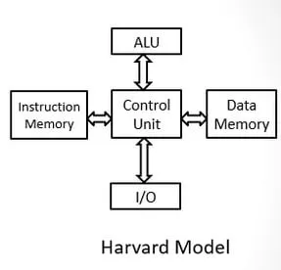
Harvard Architecture

Slide 7
Harvard architecture is a type of computer architecture that has separate memory spaces for instructions and data. It was developed at Harvard University in the 1930s, and it is named after this institution. In a Harvard architecture system, the CPU accesses instruction and data memory spaces separately, which can lead to improved performance.

Slide 8
Advantages of Harvard Architecture
The CPU can access both instruction and data memory simultaneously.
This can lead to improved performance because the CPU does not have to switch between memory spaces as often as in a Von Neumann architecture.
Additionally, because the instruction memory is typically implemented as ROM or flash memory, it is non-volatile, meaning that it does not lose its contents when power is turned off.
This makes it well-suited for embedded systems that need to operate without a constant power source.

Slide 9
Disadvantages of Harvard Architecture
As the CPU accesses instruction and data memory separately, it can be more difficult to write programs that require the CPU to modify its own code.
Additionally, because the instruction and data memories are separate, it can be more difficult to share data between different parts of a program.

Slide 10

Performance Equation
The following equation is commonly used for expressing a computer's performance ability:
CPI: Cycles per Instruction (may differ from instruction to instruction)
MIPS: Million Instructions Per Second (may be very misleading unless we know what is the instruction set. One processor may have Multiplication as basic instruction while other processor has Addition as basic instruction.

